Slide 1
Signal
Chapter III

Slide 2
Contents
Analog signal and Digital signal
Bandwidth

Slide 3
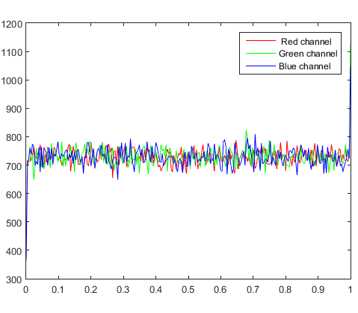
Analog signal and Digital signal
Normally, the data used by person and application in computer can not be transmitted through the physical path, it must be transformed to the electromagnetic signals that transmission media can accept

Slide 4
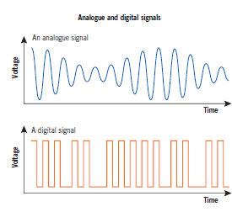
Analog signal and Digital signal
So both data and the signals can be represented into two ways is analog and digital form.
Analog signal refers to the continuous information.
Digital refers to the discrete information.

Slide 5

Analog signal and Digital signal
The sound of the human is the kind of analog data that form as the wave in the air.
The other option such as data stored in the memory formed as binary will be converted to digital signal or modulated to the analog signal depends on the time of medium.

Slide 6
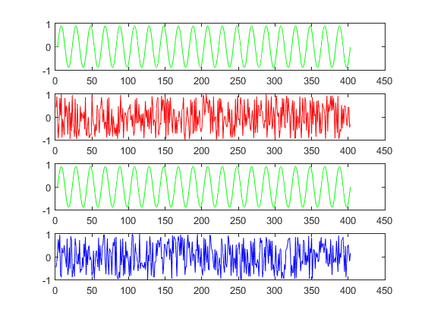
Analog signal and Digital signal
The signal can be formed into two categories: Periodic and nonperiodic (aperiodic)
Periodic signal is the kind of signal that repeat its pattern over one period while the aperiodic doesn’t repeat.
Example:

Slide 7
Analog signal and Digital signal
Periodic signal can be a simple or composite.
Simple periodic analog signal , Sine Wave can be decomposed into simpler signals.
Composite periodic analog signal is composed by multiple sine waves

Slide 8
Analog signal and Digital signal
Inside the sine wave, it contains of three main parameters such as peak amplitude, the frequency and the phase.
Peak amplitude of signal is the absolute value of its highest intensity, proportional to the energy it carries ( volts).
Example: In your house, the power can be represented by a sine wave with a peak amplitude of 155 to 170 V. While in U.S is 110 to 120V.

Slide 9
Analog signal and Digital signal
Inside the sine wave, it contains of three main parameters such as peak amplitude, the frequency and the phase.
Peak amplitude of signal is the absolute value of its highest intensity, proportional to the energy it carries ( volts).
Example: In your house, the power can be represented by a sine wave with a peak amplitude of 155 to 170 V. While in U.S is 110 to 120V.

Slide 10
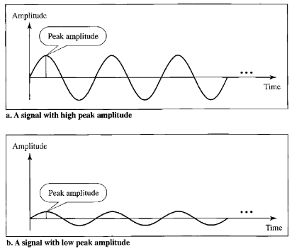
Analog signal and Digital signal

Slide 11
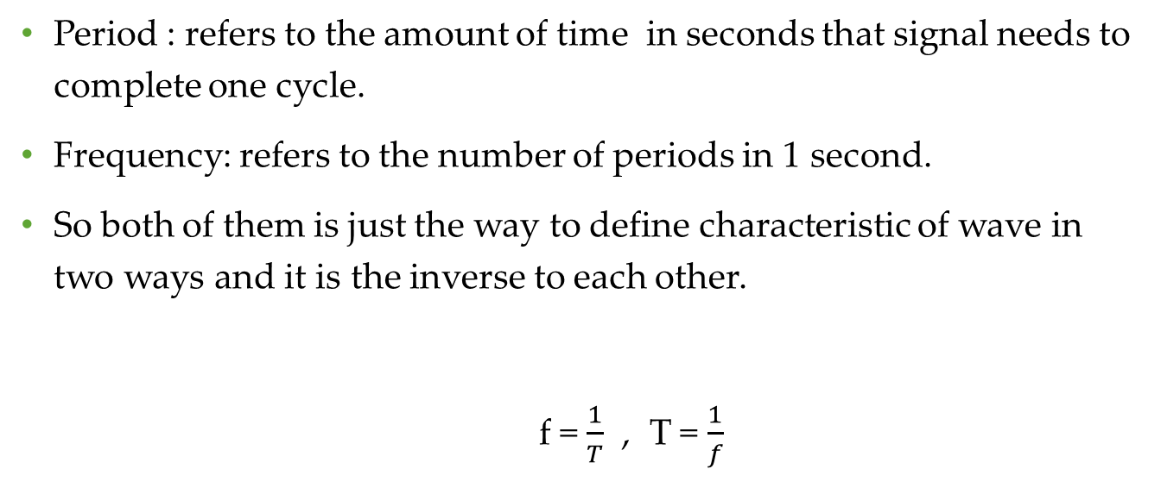
Analog signal and Digital signal
Period : refers to the amount of time in seconds that signal needs to complete one cycle.
Frequency: refers to the number of periods in 1 second.
So both of them is just the way to define characteristic of wave in two ways and it is the inverse to each other.
f = $\frac{1}{T}$ , T = $\frac{1}{f}$

Slide 12
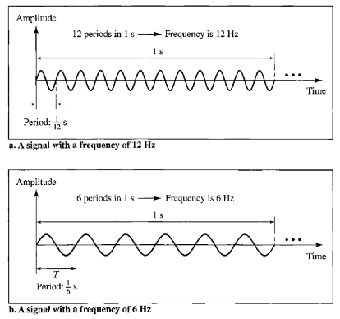
Analog signal and Digital signal

Slide 13
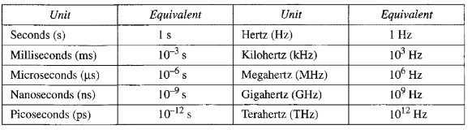
Analog signal and Digital signal

Slide 14
Analog signal and Digital signal
Frequency in other domain we can think that it is the rate of change of signal with the respect to the time.
In case that it changes in a short span of time means high frequency but it is over long span of time mean low frequency.

Slide 15
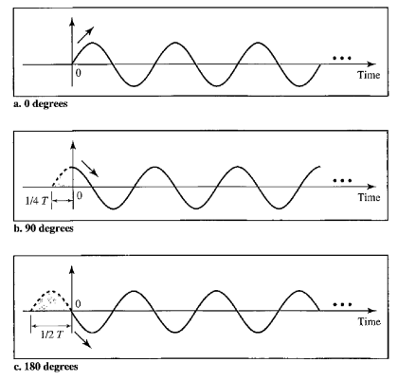
Analog signal and Digital signal
Phase: is the position of the waveform related to time 0.
Wavelength is measured by the propagation speed multiply by the period of time.

Slide 16
Bandwidth
The range of frequency in the composite signal is its bandwidth. It is the difference between the highest and the lowest frequencies of the signal.
For example if the lowest bandwidth is 1000 GHz and the highest bandwidth is 5000GHz so the bandwidth is 4000GHz

Slide 17
QandA

